Slide 1

The Ethics and Economics of Environmental Protection
7. Democracy and Deliberation
Notes:
If economists lack a theory of government, political theorists lack a theory of economics.

Slide 2

1. Prelude: Varieties of democracy
The mechanism question:
How does N (reason) arrive at 1?
The revolutionary line
Heteronomy
Autonomy
Genuine democracy type I
Democracy as equal respect
“Economy of moral disagreement”
DEMOCRACY AS DEONTOLOGY
ECONOMICS-INFUSED DEMOCRACY
Really-existing liberal democracy
Genuine democracy type II
Democracy as the common good
“The unforced force of the better argument”
DEMOCRACY AS THE PEOPLE’S CONSEQUENTIALISM

Slide 3
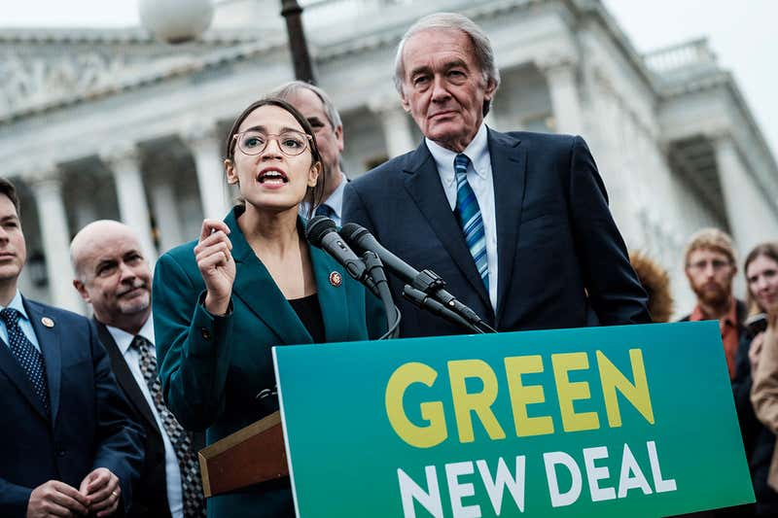
A last word on environmental economics
Economists agree on the root cause of environmental degradation
At present, people do not account for the external (social) effects of their economic decisions
The reason is that prices do not currently incorporate the necessary information or incentives
Economists also agree on the (utilitarian) nature of the solution to environmental problems
Present decision rules “block” the necessary price changes; so we need a change in the decision rule
Public goods must be brought into markets in some way so that they are efficiently allocated
They are divided, however, on the question of which mechanism will realise environmentally sustainable decisions
If people are sheepish: efficient market prices can be imposed from the centre
If people are wolvish: efficient market prices must be discovered at the periphery
The greater spotted environmental economist

Slide 4

2. A potted history of type I democracy
1950s
(U.S.) Democratic theory is dominated by elitism and pluralism
The counter-culture shines a light on the failures of liberalism; participatory democracy is born (but will die with the fading of new social movements)
Theorists inspired by the 1960s turn a new eye to American democracy: is it legitimate because it is deliberative?
The emphasis on reason is criticised for being exclusive; “deliberation” is extended to include emotion, rhetoric, storytelling
A new craze in practical deliberative experiments begins
In response to the financial crisis, theorists begin to ask: “How do we make this work at the large scale? Their answer: “The deliberative system”
1960s
1980s
1990s
2000s
2010s

Slide 5
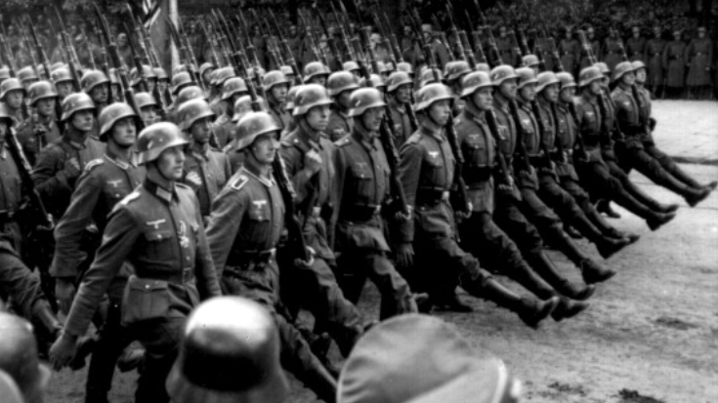
A potted history of type II democracy
c. 1800
Hegel asks of Kant: can we be free in the world? Or only the mind? Concludes for the latter, to the extreme consternation of the “left Hegelians”
Marx, most illustrious of all Hegelians, appears to show that freedom in the world is the only kind of freedom, but requires a social revolution
German Marxists despair at the descent into butchery of freedom in the world; to recover Marx, they propose to return to Hegel
Following the experience of fascism, the “critical theorists” largely conclude that reason has been eclipsed in the material world by instrumentalism
Jürgen Habermas publishes The Structural Transformation of the Public Sphere: (German) society was, for a very brief time, reasonable. This can be recovered
The Theory of Communicative Action; corresponds broadly with the first steps towards “epistemic” democracy
Between Facts and Norms
Types I and II democracy fully unite in the “systemic turn”
c. 1860
c. 1930
c. 1950
1962
1982
1996
2010

Slide 6
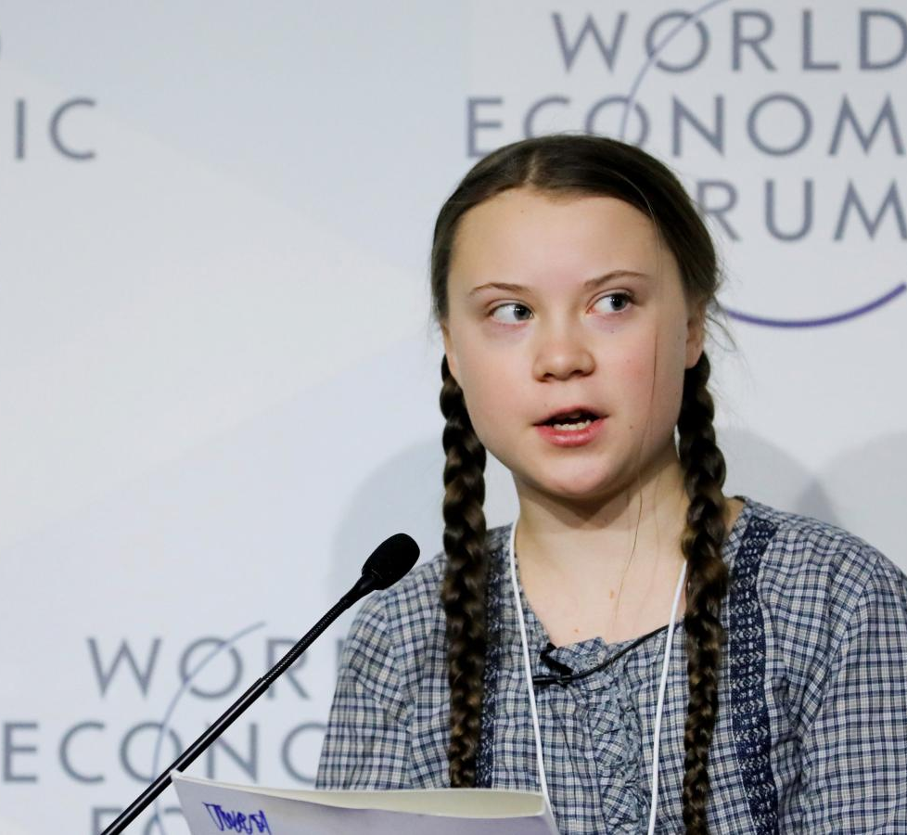
3. The democratic critique of (environmental) economics
Economists in general assume fixed preferences; there is no space for individuals to learn more ecologically sensitive values
The technocratic discourse of costs and benefits is disempowering; citizens are valued only as sources of individual preferences and not as “self-authenticating originators of claims”
Atomistic economic approaches fail to respond to the holistic nature of environmental problems
Prices impart the moral judgement that the environment can be owned, bought, and sold, in the process displacing its inherent value
Lastly, environmental economics ignores the distributional consequences of trade-offs that accept some unsustainability to promote net wealth
Democratic revolutionary?

Slide 7
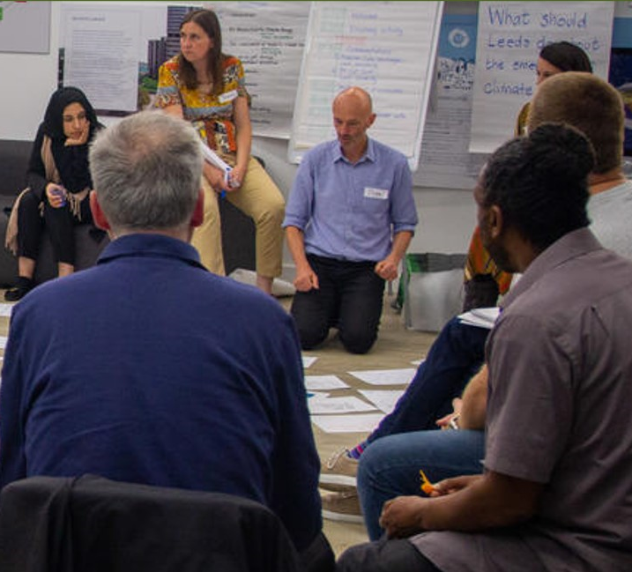
Deliberative Empowerment
Deliberation is necessary to increase the value rationality of policy decisions
Policies are never value free; like all social acts they are necessarily embedded in social and cultural contexts that rich in meanings and symbols
Deliberation is the only way of ensuring that policy properly reflects the plurality of social values
Effective solutions benefit more from the diverse, open-minded, and contextual viewpoints of ordinary citizens than generalised, distant, and narrow expertise
All interests affected by policy decisions must have a voice in those decisions, to ensure that they take into account all relevant moral effects
Effective policy solutions will be those that emerge from iterative discussions that uncover the full range of conflicts in society, and which force parties on all sides to recognise opponents
Deliberation is first and foremost an educational experience, in which the recognition of common values leads to social transformation
Democratic theorists deny that policy ever truly works from the top-down; instead, it must emerge from, and be supported by, the self-understanding and discursive reconstruction of the community itself; good policy is, in effect, policy that the people come to demand by virtue of their self-articulation

Slide 8
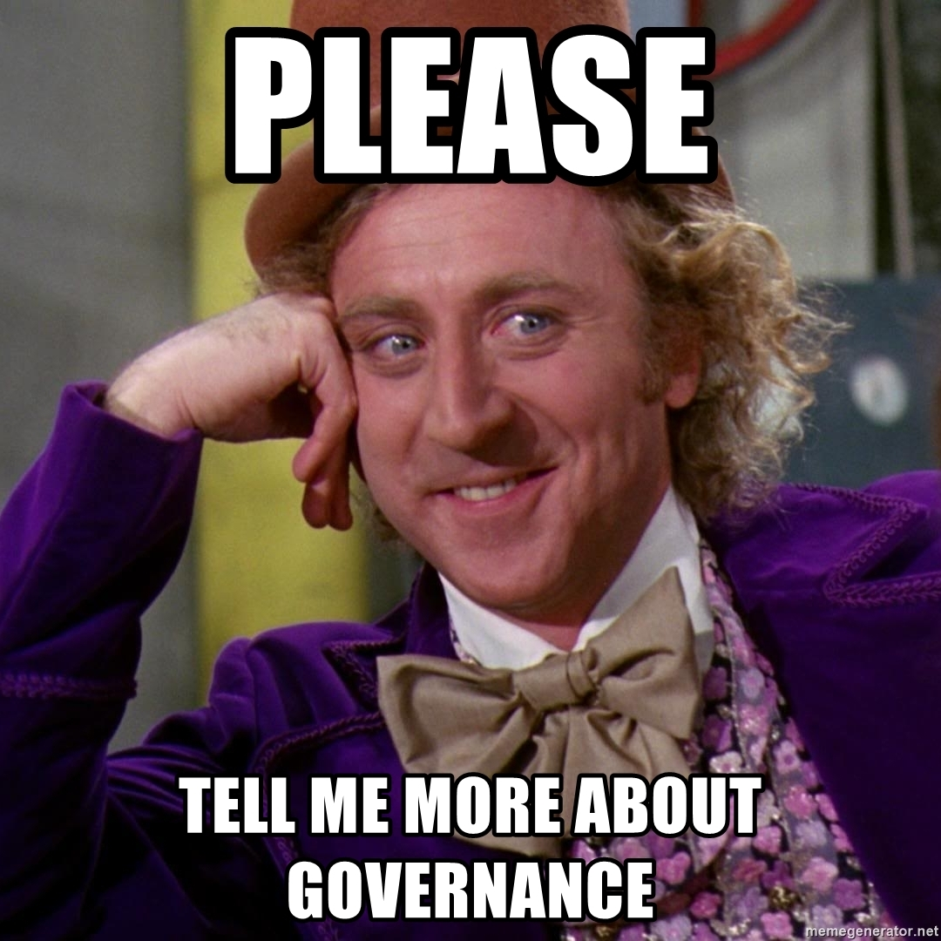
The cutting edge: “Deliberative Governance”
Deliberative responses to climate change emphasise the possibility of “nested” deliberation
The “system” consists of numerous sites of contestation and decisionmaking which, if connected, may ensure deliberative rationality across the whole
At the global level, these connections could be leveraged to ensure that elite decisionmaking is responsive to ordinary voters
This allows for “governance” rather than government: policy based on a broadly informed narrative rather than (merely) elite interests
E.g., local deliberations on climate change → national champions of climate action → Pressure groups at international conferences → more informed decisionmaking
But even informed decisions are imperfect, so out of governance comes a new impetus for change and action

Slide 9
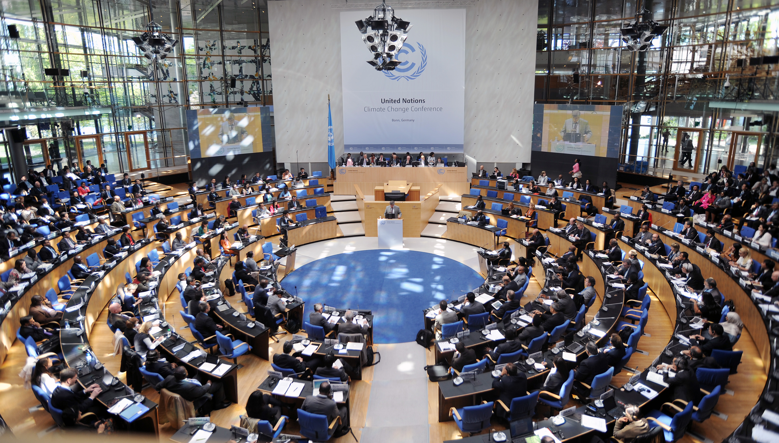
Practical examples, and the visible problem
Increasing empowerment
The UNFCCC
Habitat Conservation Planning
Citizens’ juries
Deliberative polling
The deliberative “system”
Increasing inclusion

Slide 10
4. The invisible problem, or the question of mechanisms
How do citizens recognise the correct answers to policy questions unless these answers are simply moral preferences?
The basic issue here is the conflation of type I moral agency with type II knowledge of the common good
E.g., the demand that HS2 be cancelled ≠ HS2 would harm public welfare
This is why type I and type II democracy are different: type I democracy requires that views are respected irrespective of consequences; type II democracy strictly speaking is uninterested in equality, unless it happens to promote “truth”
This problem is missed because of Habermas’s assumption that, absent the alienating influence of instrumental reason, people would automatically know what’s best for them
He interprets policy as a necessarily efficient way of subduing the populace (the “lifeworld”) to stabilise capitalism
Political debate, when it occurs (e.g., the new social movements of the ‘60s) is therefore not potential evidence that policymakers are ignorant, but that the lifeworld cannot be fully alienated (any more than the proletariat can be)
The demands of the oppressed therefore directly convey knowledge of what is in their true interests
Once Habermas had accepted in the 1990s that oppression is universal and not only capitalist (i.e., all voters are oppressed), it was possible to connect types I and II democracy, such that equal respect = common good

Slide 11
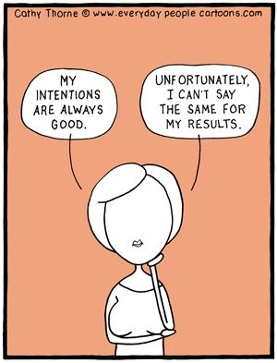
Who needs public policy? (Or, the unscience of revolution)
If intentions directly determine outcomes, then democratic theory supplies all our environmental answers
In other words, do we need a scientific theory of social behaviour?
Democratic/political theorists proceed as if we don’t: all that matters is that democratic publics arrive at decisions with which they agree (e.g., John Dryzek’s work)
If intentions bear no direct, constant, or visible relation to outcomes, then democratic theory supplies zero answers
The fundamental problem we face is one of pervasive unintended consequences—or more simply, uncertainty
In deliberative governance, we find a grudging acceptance for the need for “experts” (via the “division of cognitive labour”)—but this only compounds our problems
How do the experts solve the problem of uncertainty?
Even if one or more experts does happen on the right answer, how do voters (non-experts) recognise them?

Slide 12

5. Summary
We continue to see that utilitarianism—and the economics is supports—is controversial; from the democratic theory point of view, the problem emerges from its use to justify public passivity and inequalities of power
Type I theories object to (utilitarian) liberal democracy because it is unreasonable, because it militates against equal respect, and because it obstructs genuine self-determination
Type II theories object to it because it is dehumanising, and because it occludes the freedom that comes through self-legislating the true common good
These theories are subtly different, but they supply similar and even overlapping views of “deliberative empowerment” vis-à-vis environmental goods
Deliberative solutions consist of genuinely inclusive discussions over our policy options to ensure that we choose those options that are justifiable to everyone affected
In practice, this ideal may require some fudging: as long as policymakers are aware that the masses (the “system”) are annoyed, is that enough?
It is when we apply critical pressure that the difference between types I and II views matters
If everyone just knows what’s in their interests, then equal respect will unveil what policies achieve the common good. But is this a tenable assumption?

